Slide 1
We just don’t draw wires,
we draw customer satisfaction

Slide 2
Contents
Contents | Page no.
Organization Profile | 5-8
Product Portfolio | 10-15
Process flow | 17
Machinery and Equipments | 18-20
Quality and Quality Management Systems | 22-24
Key Customers | 26-28
Improvements | 30
Social responsibilities | 32-33

Slide 3
ORGANIZATION PROFILE

Slide 4
Know our history
H D Wire (P) Ltd was established in the year 1988 and has established its manufacturing unit at Sector-E, Industrial Area, Indore (MP) in the year 1994.
Today H D Wire (P) Ltd has completed its glorious 28 years in commercial production and achieved various milestones. Here are few glimpses during the journey of 28 years:
In year 1994, the production started with mild steel wire drawing unit with a capacity of 3000 MT per annum.
In a very short span the company has installed galvanizing and patented plant of 60 lines which was biggest in Madhya Pradesh, currently 196 lines are installed.
H D Wire was the only manufacturing unit with whom Tata Steel Limited associated for job work for galvanizing products till the year 2011-12.
In year 2013, H D Wire was awarded 2nd rank in India SME 100 Awards under Engineering Category.
In year 2015, our Chairman Shri Dilip Dev was conferred with Business Leadership Award for Industry Development (Manufacturing/Services).
We just don’t draw wires, we draw customer satisfaction

Slide 5
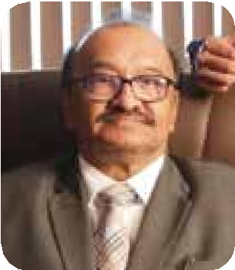
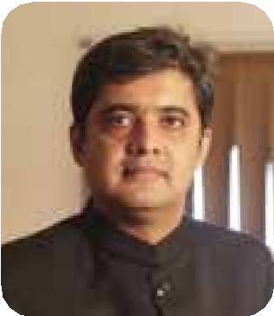
Promoter Team
Mr. Dilip Dev
Chairman
Mr. Dheeraj Dev
Managing Director
Mr. Dilip Dev is a Masters in Economics & Commerce from Indore University, DAVV. He joined Dev’s group in the Biscuits – Confectionary division at an age of 17 years while he was pursuing higher studies. In the forming years of his career, he got exposure within different manufacturing divisions of the group, namely, Metal containers and printing and Cine exhibition. While enriching his professional experience, he also did double post graduation and completed LLB (Hons).
In 1994, he laid the foundation stone of H D Wire (P) Ltd as a single product, mild steel wire-drawing unit with a capacity of 3000 Mt per annum. Today, under his guidance, H D Wire produces a plethora of Mild steel & High carbon round as well as formed wires and wire products. The company also serves the fabrication and reinforcement industry with its range of fasteners, welding electrodes, and wire welded mesh.
An exceptional orator and team player he is actively involved Elected Member of AIMP (Association if Industries Madhya Pradesh) and has served various Presidential and other posts in Lions Club.
Mr. Dheeraj Dev is a Masters in Business Administration in finance from DAVV University Indore. He is also a Bachelor of Engineering in Electronics from Mumbai University.
He started his professional journey with the welded mesh department as a machine operator and believes that efficient and effective operations originate when working is done at the grass-root level. He joined H D Wire (P) Ltd in 2001 when the company was clicking a turnover of Rs. 1.05 Crores and looks after Marketing and Finance portfolio in the company. Under his aggressive marketing style the organization achieved the record breaking turnover of Rs. 512.48 Crores in 2021-22.
An inspiring leader, his team always delivers to the next level in production parameters under his unique approach to everything that is simply summarized as “What Next ?”
We just don’t draw wires, we draw customer satisfaction

Slide 6
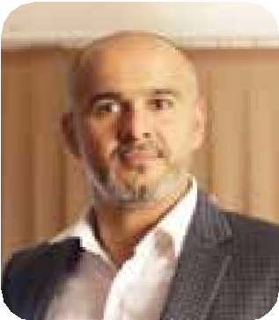
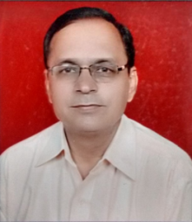
Promoter Team
Mr. Himanshu Dev
Managing Director
Mr. GS Keshwani
Technical Director
Shri Himanshu Dev is Masters in Business Administration (Marketing) and he joined the company in the year 2011. A dynamic professional with diverse & rich experience of 19 years in Service & Manufacturing, he has been instrumental in providing new direction to the marketing department and placing the company on the national and global map. With a humble beginning as a Marketing & Sales officer in Telecom sector to being the Operations Head further looking manufacturing & plant administration for the Steel Manufacturing sector is a story of continual learning & development. He manages the production operations churning out 65,000 tons of steel wires per annum, managing a workforce of more than 500 people. Production department and HR & Administration team work under his guidance.. .
Shri GS Keshwani has 32 years of hands on experience with TATA Steel in Production & Quality Management System.
A graduate in Science certifications, and has a vast experience in Operations, Audit systems, Safety.
His key areas of expertise include Total Quality Management System and has rich & well rounded exposure to the dynamics of Quality Management System  He brings to the table more than 3 decades of cross functional experience from Steel Industry  Key area is wire Drawing process.
He has pioneered TQMS and has clear understanding how compliance with Quality standards can improve the efficiency, economy & profitability of the operations
We just don’t draw wires, we draw customer satisfaction

Slide 7
Company Background
Year of
Establishment
19 May 1988
Production Capacity
150,000 MT/PA
No. of
Employees
750
Annual
Turnover
500 Cr.
Location
Indore
Head office & plant is located at Indore and sales officers are located at
Pune, Nashik (Maharashtra), Delhi (NCR), Hyderabad Karnal (Haryana)
Product Basket
GI Wire, ACSR Wire, Cable Armour Wire, Cable Tape, Binding Wire, Barbed Wire, Chain Link Fence, Spring Steel Wire, Steel Rope Wire, RQ/FQ Wire, Patented black as well as Patented Galvanized Wires

Slide 8
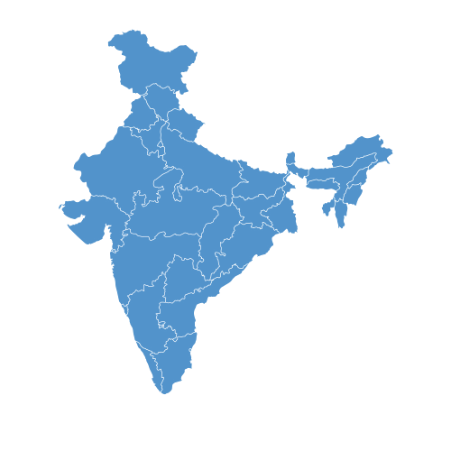
Location of Plant
In the heart of India
Our facilities are situated on the Strategic location i.e., in the central part of the country Indore (Madhya Pradesh) giving access to all the markets in the country & excellent connectivity of the plant location by rail & road with major consumption centers in the country.
INDORE
Indore
We just don’t draw wires, we draw customer satisfaction

Slide 9
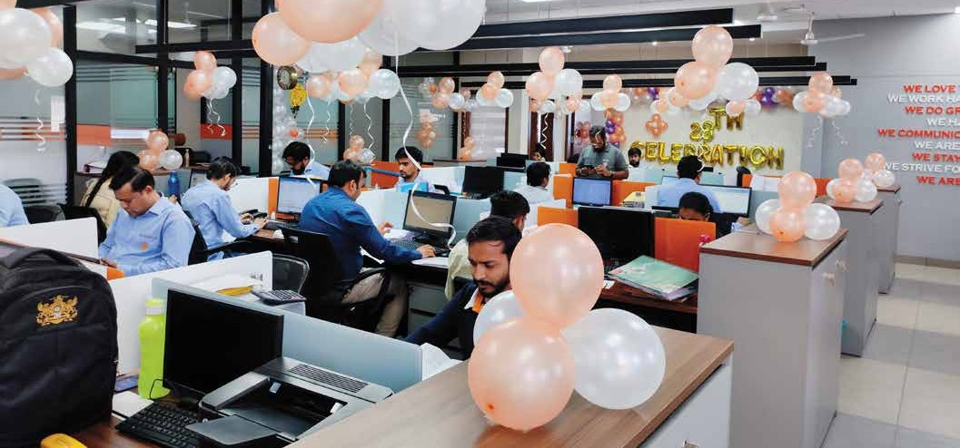
Corporate Office

Slide 10
PRODUCT PORTFOLIO

Slide 11
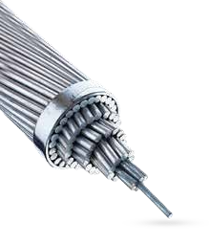
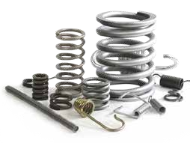
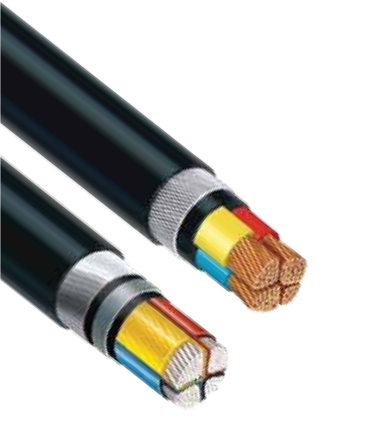
Product Portfolio
H D WIRE (P) LTD was established in the year 1988 and the manufacturing story started back in the year 1994 in Indore, which is now a recognized name in the manufacturing, supplying, exporting, and trading of Wire & Cable Products in India.
Product range are as follows:
Cable Armor Wire & ACSR (Power Sector)
Galvanized wire (Farming and Fencing)
Binding Wire & Weld Mesh (Infrastructure)
Spring Steel and Rope Wire (Auto Sector)
We just don’t draw wires, we draw customer satisfaction

Slide 12
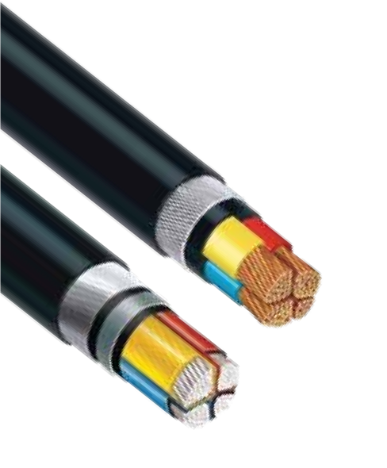
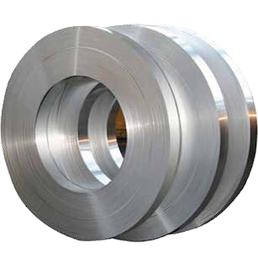
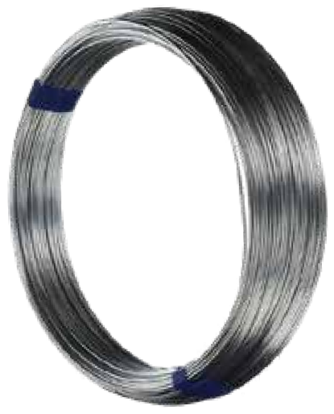
Product Segment
Railways
Power & Transmission
Cable Tape
ACSR Wire
Cable Armour Wire
Earth Wire

Slide 13
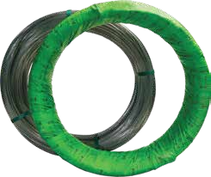
Product Segment
General Engineering
Poultry & Farming
General Engineering
Poultry & Farming

Slide 14
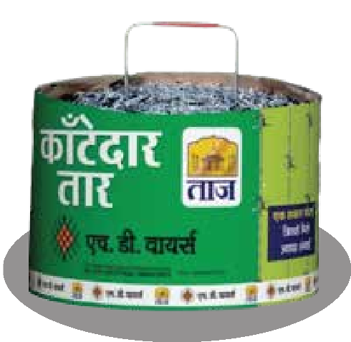
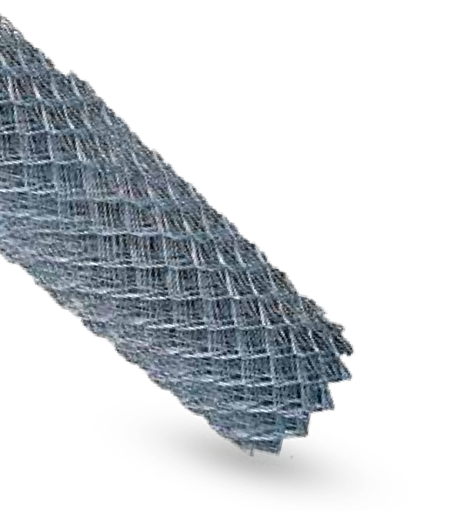
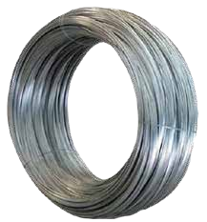
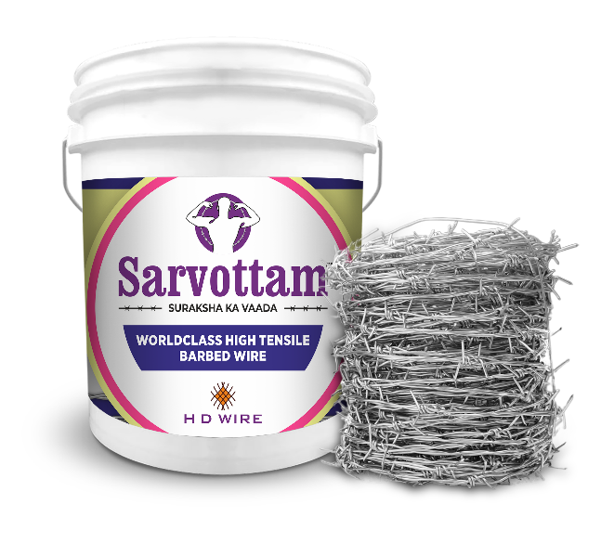
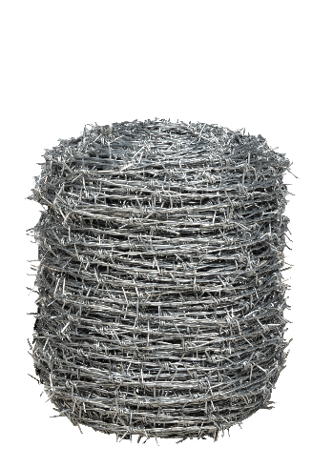
Product Segment
Fencing
Barbed Wire
Chain Link Fence
GI Wire
High Tensile Barbed Wire

Slide 15
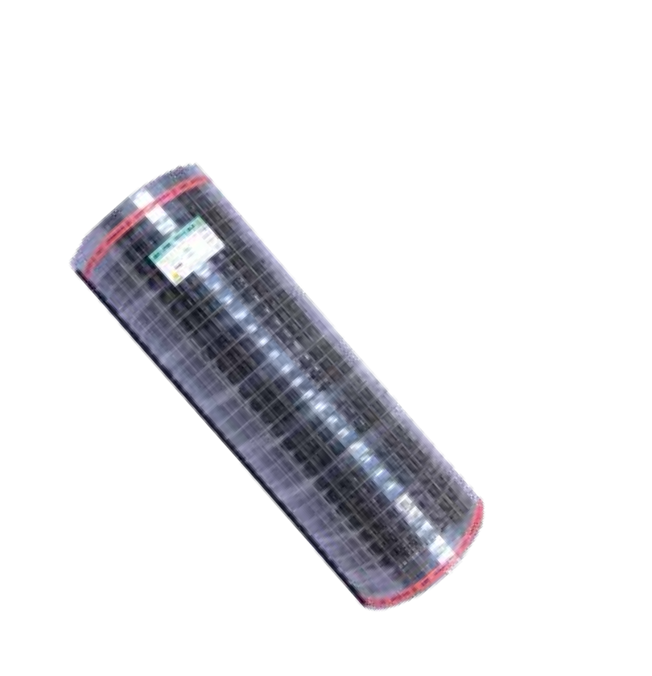
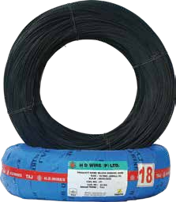
Product Segment
Infrastructure
Weld Mesh
Binding Wire

Slide 16
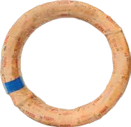
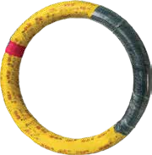
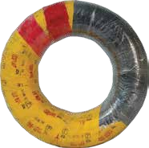
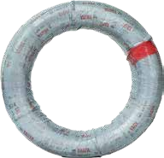
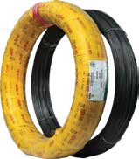
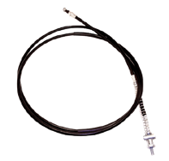
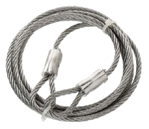
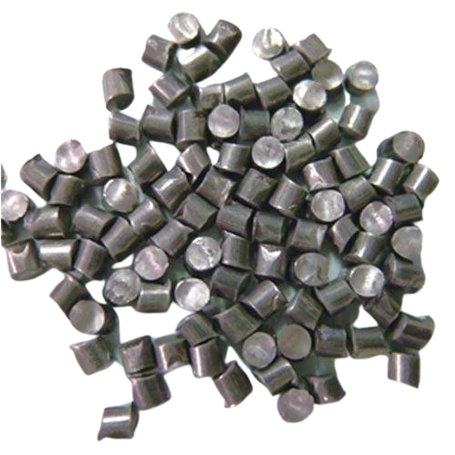
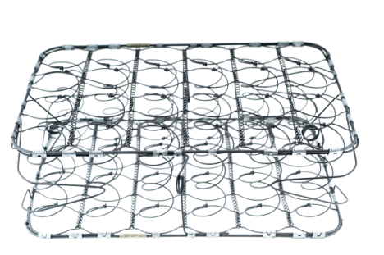
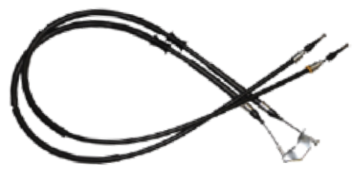
Product Segment – to explore with MMI
High Carbon Wire Products
Spring Steel / Music Wire
RQ/FQ Wire
(Black & Galvanised)
Steel Rope Wire
(Black & Galvanised)
Cut Short Wire
Mattress Spring Wire

Slide 17
PROCESS FLOW
MACHINERY AND EQUIMPEMNTS

Slide 19
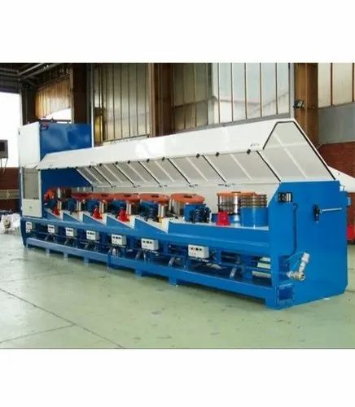
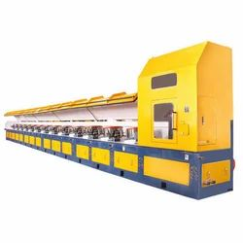
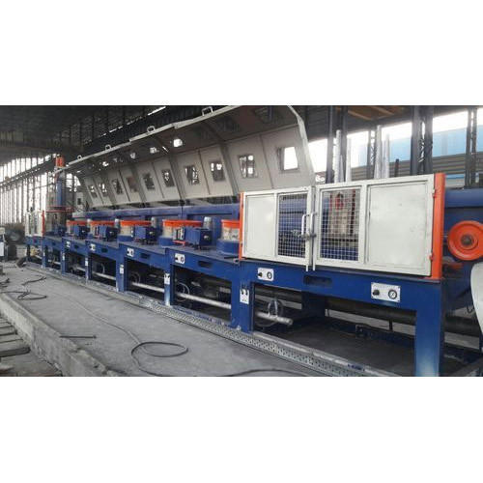
STSTRAIGHTLINE WD MACHINES

Slide 20
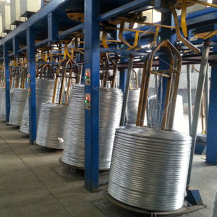
Galvanized wire Take ups(VDC)
Capacity of the Galvanized line 45000 Ton/Month
We just don’t draw wires, we draw customer satisfaction

Slide 21
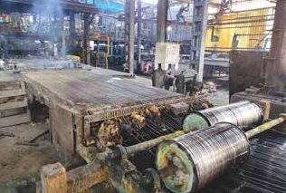
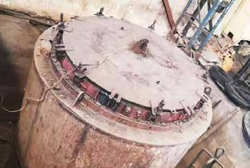
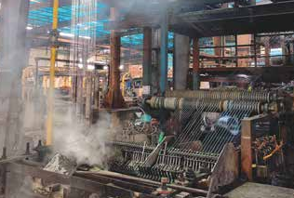
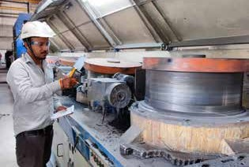
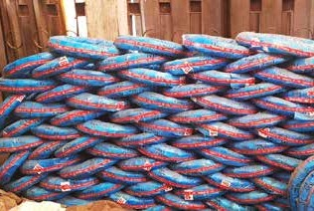
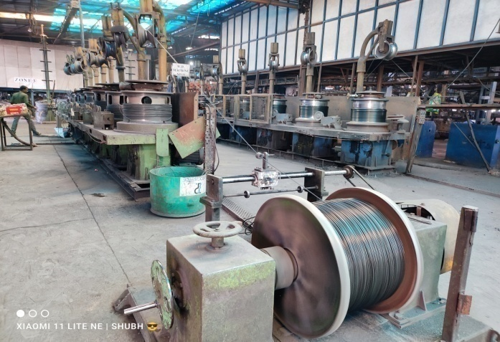
Production Glimpses
Galvanizing Line
Annealing Furnace
Inline Pickling
Wire Drawing Machines
FG Stockyard
Direct Drawing

Slide 22
QUALITY ASSURANCE
AND
QUALITY MANAGEMENT SYSTEMS

Slide 23
H D Wire (P) Ltd. , Indore
Product Manufacturing Process and Inspection
Wire Rod (Raw Material)
Pre Wire Drawing
Patenting / Galvanizing
Inspection and Testing
Packing
Quality INSEPCTION at every stage
Dispatch

Slide 24
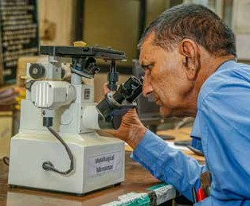
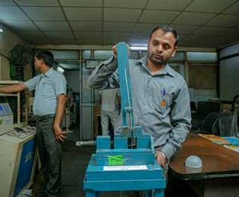
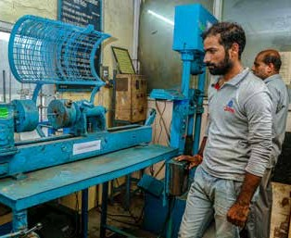
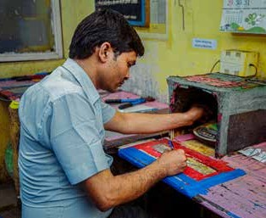
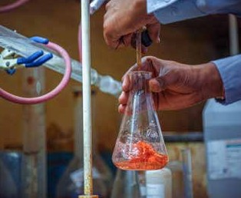
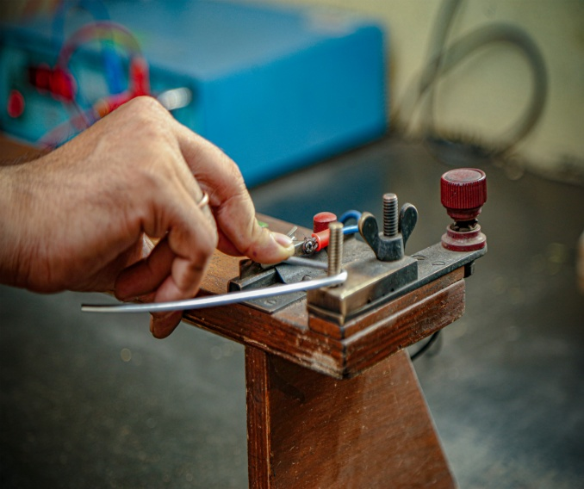
Laboratory Facilities
Micro Scope
Bending Test
TorsionTest
Weighting scale
Chemical Testing
Resistivity Test

Slide 25
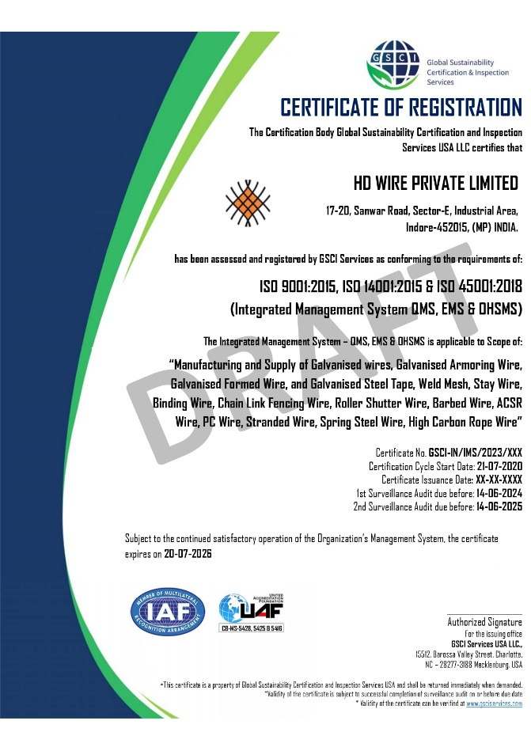
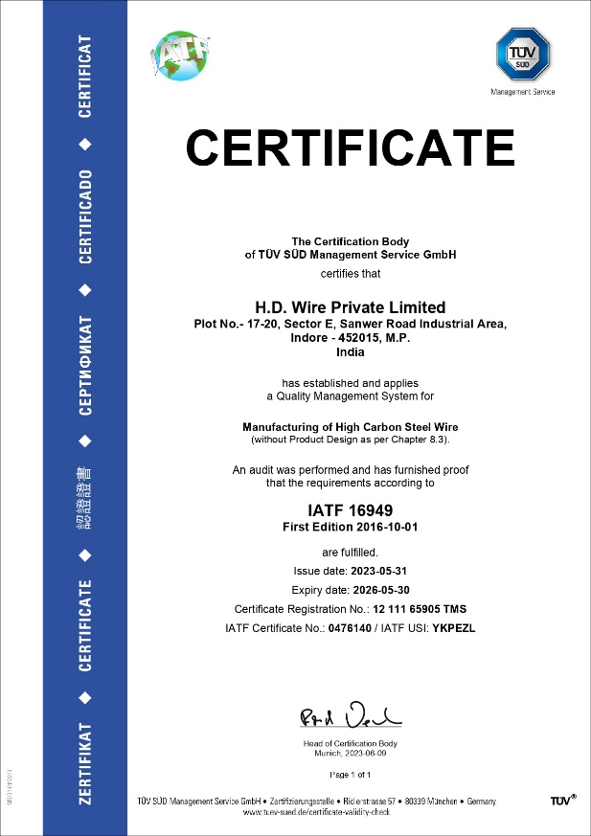
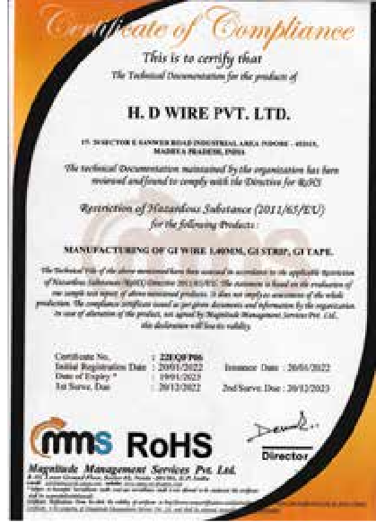
Quality Management Systems The organization is certified with QMS ( ISO 9001-2015, 14001, 45001, ROHS, and IATF)
ISO-9001-2015, 14001, 45001
IATF
ROHS

Slide 26
CUSTOMER REACH

Slide 27
Customers Location in India
Jammu &
Kashmir
Himachal Pradesh
Punjab
Uttarakhand
Haryana
Rajasthan
Uttar Pradesh
Gujarat
Madhya Pradesh
West Bengal
Indore
Maharashtra
Telangana
Goa
Karnataka
Kerala
Tamil Nadu
We just don’t draw wires, we draw customer satisfaction

Slide 28
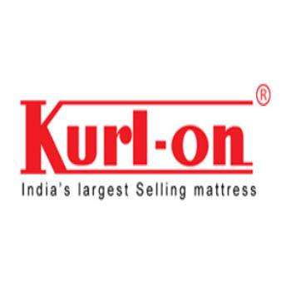
Our Prominent Customers - Domestic

Slide 29
List of countries where products are exported
Qatar
Dubai
Bahrain
Bangladesh
Nepal
Sri Lanka
Uganda
Ghana
Tanzania
Portugal
Argentina
Germany

Slide 30
Sales Expo and Exhibition Glimpses
Wire & Tube 2022, Dusseldorf, Germany
Wire India Exhibition 2022, Mumbai
Poultry India Expo 2022, Hyderabad
Krushi Mela 2022, Surat
Agri & Horti Technology Expo 2022, Bhopal
Farm Tech Asia Expo 2022, Indore

Slide 31
IMPROVEMENTS

Slide 32
Improvements (Continual improvement)
Improvements | Advantages
Using clean fuel for firing of the reheating furnace Viz:- Bio Gas /PNG) | This is clean gas and environment friendly.
Re heating furnace is redesigned | Reduce the fuel consumption per ton.
Pay off bobbin capacity increased from 150/500 kg to 1000 Kg by changing pay off design | Improvement in productivity.
Wiping process modified from spring wiping to pad wiping | Uniform zinc coating and the coating cpK improved from 0.70 to 1.0
Wire Rod cleaning by de-scale route in place of acid cleaning | De- scale route is environment friendly and the scale is recycled for construction purpose.
Introduce solar system for energy supply. | Reduce carbon foot print

Slide 33
SOCIAL RESPONISBILTY

Slide 34
CSR Activities
We always remember to pay back to the society……….

Slide 35
Employees Engagement Activities

Slide 36
Celebration of 25 Years of Customer Satisfaction

Slide 37
Contact us
www.hdwires.com
17-20, Sector E, Sanwer Road,
Industrial area, Indore-452015
0731-4211199, 0731-4211124
sales@hdwires.com,
hdwires@hdwires.com exports@hdwires.com

Slide 38
Thank You

